Slide 1
optical spectrum analysis
4th December 2018

Slide 2
Revisit the grating
Ronchi ruling
Consider an object with periodic structure such as the Ronchi ruling, a grating of parallel straight lines with large grating space, whose opaque and transparent regions are of equal width.
The object is illuminated from behind by a monochromatic plane wave.
The Ronchi ruling acts as a course grating producing a series of bright spots that correspond to the various order of diffraction.

Slide 3
y
Optical axis
Suppose the spectrum of bright spots are aligned along the Y-axis.
According to the grating equation, where d is the spatial period of the ruling and
f is the focal length of the transform lens.
Spots appear at distances Y_{m} from the optical axis is given by
http://iopscience.iop.org/article/10.1088/0031-9120/29/3/003/pdf

Slide 4
Revisit Fraunhofer diffraction
Recall 2D Fourier transform
This shows that the amplitude distribution or Fraunhofer diffraction pattern A_{p} (k_{X},k_{Y}) actually is the 2D Fourier transform of the aperture function E_{A} (x,y).
Also, recall the angular spatial frequencies,
Under this circumstance, the amplitude distribution is focused on y axis only and distance r₀ is replaced by the focal length f.
The angular spatial frequency becomes
By definition, the angular spatial frequency may be written as
This gives corresponding to the spectrum of spatial frequencies displayed in the
diffraction pattern.
Notes:
The key point : the field distribution in the Fraunhofer diffraction pattern is the Fourier transform of the field distribution across the aperture (i.e., the aperture function)

Slide 5
Spectrum of spatial frequencies :
The central spot with m = 0 corresponds to a normalized spatial frequency ν_{Y} = 0, the DC component.
The first order (m = 1) spots above and below the central spot represent the fundamental spatial frequency ν_{Y1} = 1/d.
Higher order (m>1) spots represent higher harmonics given by mν_{Y1} .
Each spot of light in the diffraction pattern denotes the presence of a specific spatial frequency, which is proportional to its distance form the optical axis (zero-frequency location).
Notes:
จากการวิเคราะห์พบว่า spatial frequency ค่าสูงสัมพันธ์กับ bright spots ที่อยู่ไกลจาก central spot

Slide 6
Example
Consider a Ronchi ruling with slits of width 0.1 mm illuminated by light of wavelength 488 nm. A lens of focal length 40 cm is used.
Determine
(a) the distances of the m = 1 and m = 3 spots from the central DC spot in the diffraction pattern on the screen in the spectrum plane.
(b) the angular spatial frequencies associated with the m = 1 and m = 3 spots.

Slide 7
A set of spatial frequency components is evident when the Fourier transformed of the object, i.e., the square wave grating, is performed.
Since the grating is a periodic object, the transform in this case reduces to a Fourier series.
The diffracted spots in the image (or transform) plane are observed as a result of a set of sinusoidal spatial frequency components.
How many spots will be seen if the square wave grating is replaced by sinusoidal grating?

Slide 8
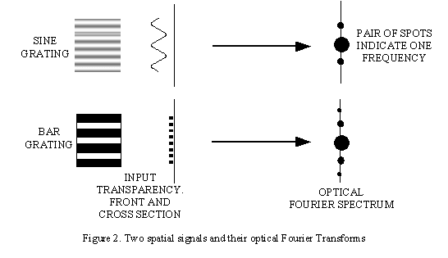
How many spots will be seen if the square wave grating is replaced by sinusoidal grating?
http://www.eng.warwick.ac.uk/~espbc/courses/undergrad/lec8/Image2.gif
Notes:
The sinusoidal grating has a pattern like a sinusoidal standing wave, which requires the superposition of two oppositely directed traveling sine waves to synthesize it. If we now use this grating to diffract monochromatic light we will get two first-order diffracted spots, symmetrically displaced on each side of the straight through direction, and corresponding to the two oppositely directed sinusoidal components.

Slide 9
Diffraction pattern from horizontal lines of varying widths

Slide 10
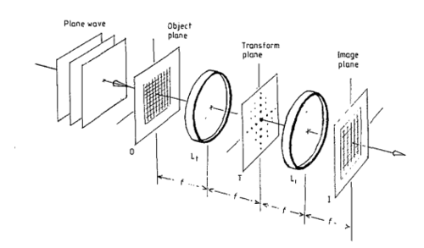
4-f coherent imaging system
An object is illuminated by a plane wave emitted from a laser.
Two identical lenses T_{t} and T_{i} represent perform transform and inverse transform, respectively.
This system performs the spatial filtering by which certain spatial frequencies that make up and object are removed.
This can be done by inserting an appropriate mask at the transform plane T.

Slide 11
Image of fine wire seen on image plane without filter
Diffraction pattern of wire mesh on transform plane

Slide 12
Which image is produced by blocking high spatial frequency components in horizontal components?
√
Notes:
This image is observed on the image plane.

Slide 13
Different images are obtained when only certain parts of the diffraction pattern are permitted to contribute to this image. The other portions of the diffraction pattern are blocked by opaque tape.

Slide 14
How does an image appears if all spots are blocked except the DC component, or undeviated diffraction?
From the knowledge of Fourier series, the finer features of the image disappear when spots corresponding to the higher spatial frequencies are blocked.
A diaphragm can be used to blocked all spatial frequency components except the DC component.
From the point of view of optical filtering, the diaphragm, which blocks all but frequencies near the direct beam, functions as a low-pass optical filter.
A diaphragm, which blocks only those frequencies near the direct beam, functions as a high-pass optical filter.
A clear annular ring, which blocks the lowest and the highest frequencies, functions as a band-pass optical filter.

Slide 15
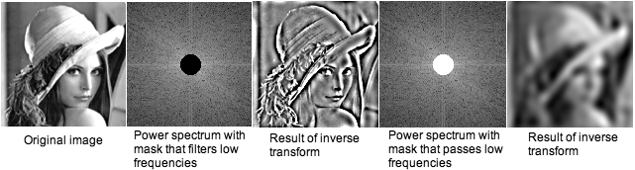
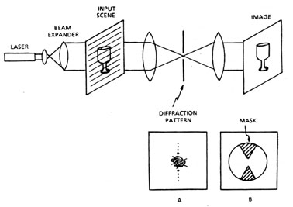
Optical filtering of horizontal line from the original image
http://lipas.uwasa.fi/~TAU/AUTO3160/slides.php?Mode=Printer&File=4000Fourier.txt&Page=-1&MicroExam=Off&Images=Own&Menu=Off&Brother=Big

Slide 16
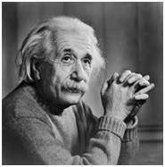
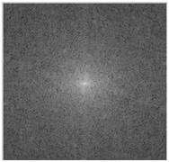
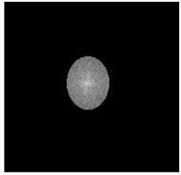
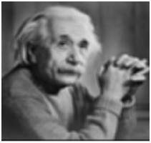
What kind of an optical filter is used?
Image in frequency domain
(diffraction pattern)
Applying ……… filter
over this image
Sample image
Resultant Image
https://www.tutorialspoint.com/dip/high_pass_vs_low_pass_filters.htm
Notes:
In this case, the low pass filter is used. The high pass frequency components denotes edges whereas the low pass frequency components denotes smooth regions.
With the same way, an ideal high pass filter can be applied on an image. But obviously the results would be different as, the low pass reduces the edged content and the high pass increase it.

